Slide 1
VE230 Recitation Class 7
by Li Chunchao
2017/11/23

Slide 2
Short Review

Slide 3

E-M induction
Motional emf
Flux rule for motional emf
current generators (slidewire, disk dynamo, alternator)
Lenz’s rule

Slide 4
E-M induction
induced (transformer) emf
Faraday's law
Induced electric field

Slide 5
Electromagnetic Waves
Wave equation
Wave characteristics
E-M wave equation
Polization
Poynting vector
Standing wave

Slide 6
Solving Problems

Slide 7
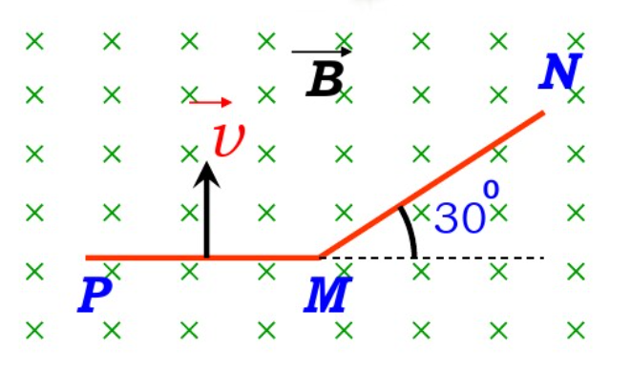
E-M induction
Find the emf between P and N. The side length is L.

Slide 8

Solution
We find the force on the left part first.
$$ε=\vec{v}×\vec{B}dl=vBL$$
Then we find the force on the left part .
$$ε=\vec{v}×\vec{B}dl=\frac{\sqrt{3}}{2}vBL$$
Hence the total emf is
$$ε=(\frac{\sqrt{3}}{2}+1)vBL$$

Slide 9

E-M induction
There is a disk conductor, it rotate according to its axis with ω. There is not resistance for the disk conductor. Find the current through the resistance ab (including direction)

Slide 10
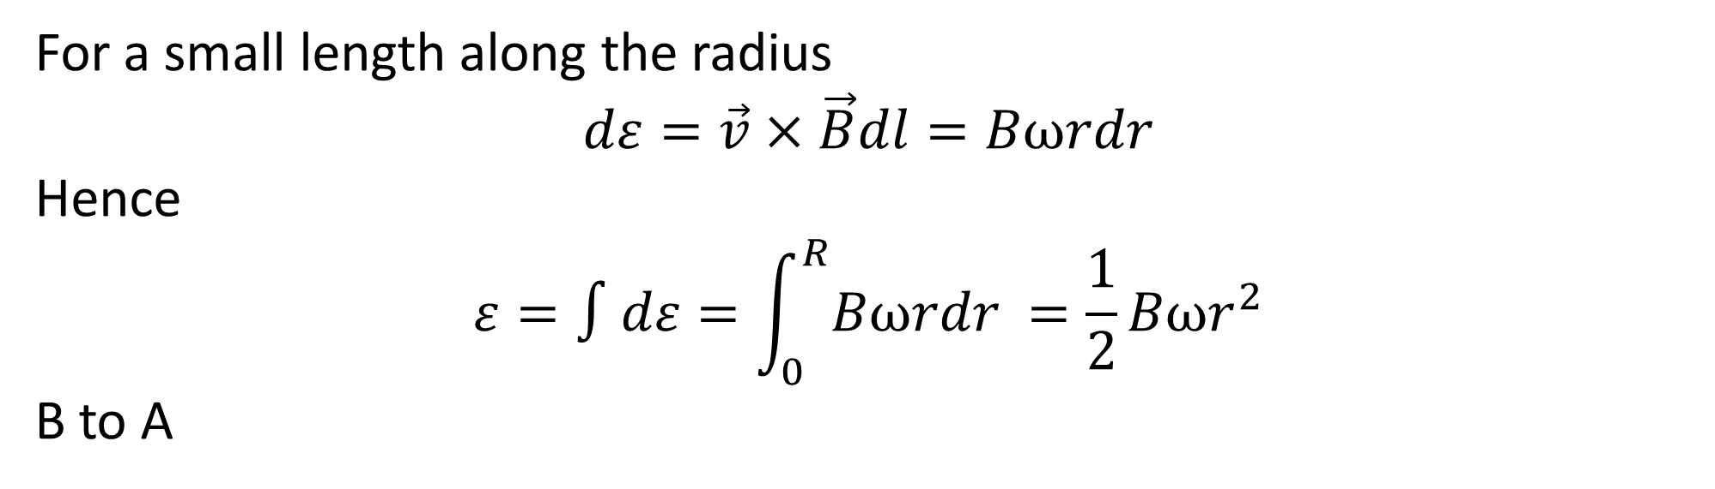
Solution
For a small length along the radius
$$dε=\vec{v}×\vec{B}dl=Bωrdr$$
Hence
$$ε=∫dε=\int_{0}^{R}{Bωrdr }=\frac{1}{2}Bωr^{2}$$
B to A

Slide 11
E-M induction
If there is a magnetic field $B=B_{0}\sin{ω_{1}t}$ in z direction. A square conductor loop with side length a rotating according to the x axis with ω2. The initial position is in x-y plane. What is the emf in the conductor loop according to time.

Slide 12
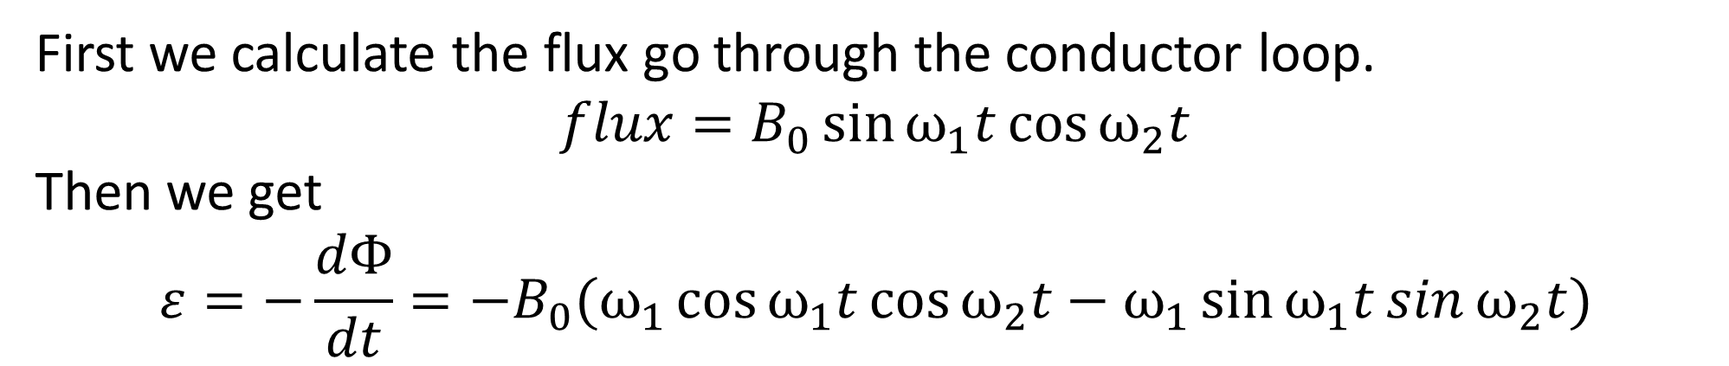
Solution
First we calculate the flux go through the conductor loop.
$$flux=B_{0}\sin{ω_{1}t}\cos{ω_{2}t}$$
Then we get
$$ε=−\frac{dΦ}{dt}=−B_{0}(ω_{1}\cos{ω_{1}t}\cos{ω_{2}t}−ω_{1}\sin{ω_{1}t}\sin{ω_{2}t})$$

Slide 13
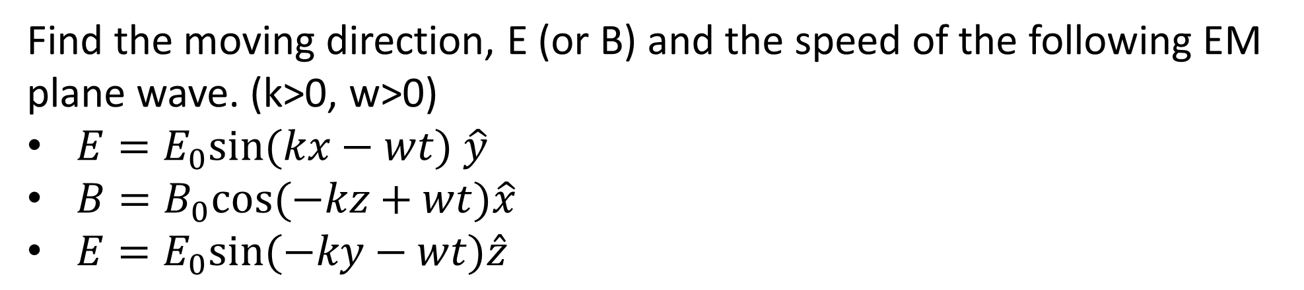
EM Wave
Find the moving direction, E (or B) and the speed of the following EM plane wave. (k>0, w>0)
$E=E_{0}sin⁡(kx−wt)$ $\hat{y}$
$B=B_{0}cos⁡(−kz+wt)\hat{x}$
$E=E_{0}sin⁡(−ky−wt)\hat{z}$

Slide 14
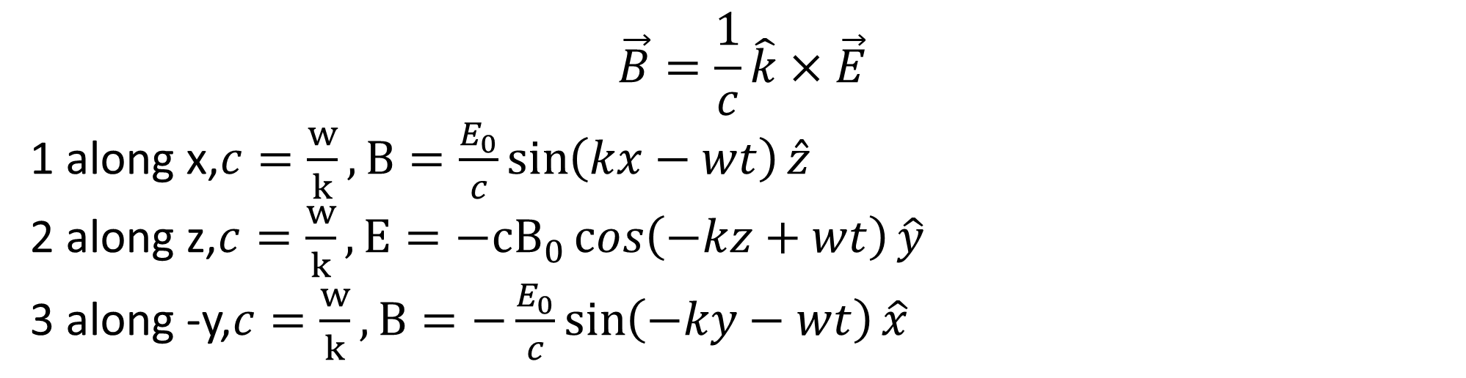
Solution
$$\vec{B}=\frac{1}{c}\hat{k}×\vec{E}$$
1 along x,$c=\frac{w}{k},B=\frac{E_{0}}{c}\sin\left(kx−wt\right)\hat{z}$
2 along z,$c=\frac{w}{k}, E=−{cB}_{0}\cos\left(−kz+wt\right)\hat{y}$
3 along -y,$c=\frac{w}{k},B=−\frac{E_{0}}{c}\sin\left(−ky−wt\right)\hat{x}$

